Slide 1
Lab03 Code Review

Slide 2
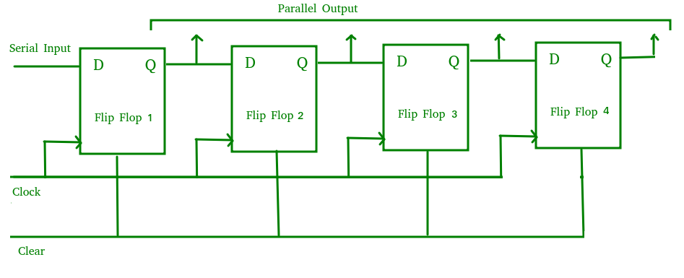
參考架構 (SIPO Shift register)

Slide 3
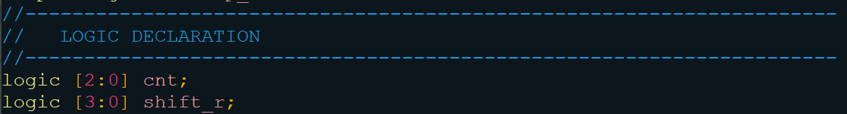
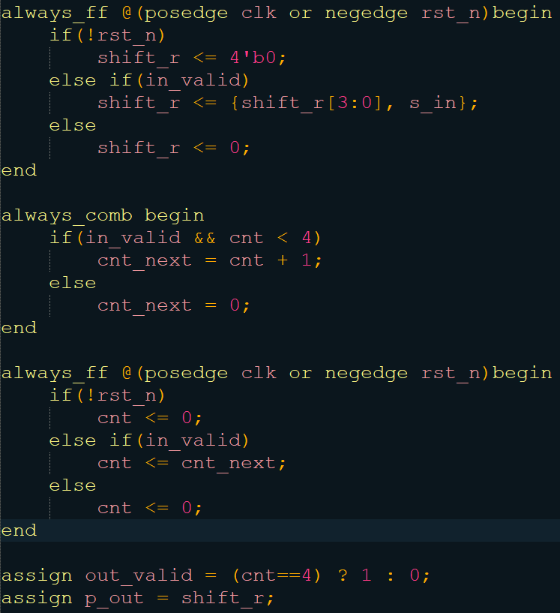
Reference code

Slide 4
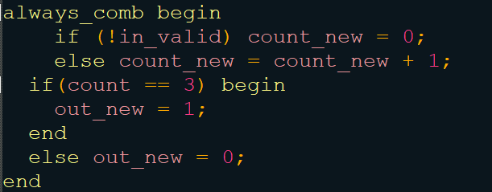
Bad coding example
Combinational loop

Slide 5
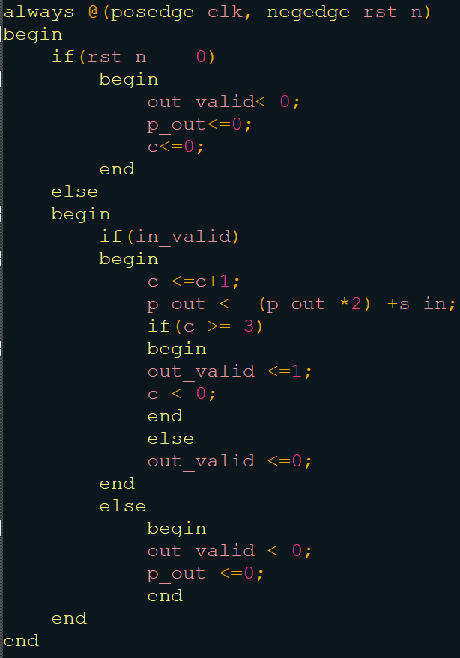
Bad coding example
Separate combinational and sequential blocks

